Slide 1

Module 8
Methods and Unity Classes

Slide 2
Learning Objectives
Explain how parameters work
Develop a console app with all 4 kinds of methods

Slide 3
Content (slot 1)
A Brief Review
Deciding Which Methods to Use
Figuring Out Information Flow
Creating the Method Header
The Method Body
Parameters and How They Work
Passing Objects as Parameters

Slide 4
8.1 A Brief Review
How we actually decide which methods we should use?
If the method doesn’t return anything we set the return type to void, but if the method does need to return a value to the code that called method we set the return type to the data type of that value.
Use public methods when we wanted the consumers of the classes to be able to use those methods.
Private methods are useful inside the classes that contain them, but there’s no reason for a consumer of the class to call those methods directly.

Slide 5
8.2 Deciding Which Methods to Use
We’ll decide which methods to include in a class by thinking about the behavior that class needs to provide. One of the things that really helps us do this is the realization that many of the classes we design are actually used to model entities in the real world.
We can think about how the real world entity behaves and decide which of those behaviors will be useful in the software class.
Example: We used this approach for our Deck class in the previous section, exposing Shuffle, Cut, and TakeTopCard methods because shuffling, cutting, and taking the top card are things we do with real decks of cards.
We generally won’t realize we need those methods when we think about the behavior of the real world object we’re modeling; instead, we’ll usually discover them when we Write the Code.

Slide 6
8.3 Figuring Out Information Flow
Why do we need to figure out the information flow for our methods anyway?
Because we're going to need to use parameters for any information that comes into the method and we're going to need to return whatever information needs to come out of the method. Before we can actually write our methods, we have to know what parameters and return types we need.
Revisit the methods from the Deck class:
The constructor doesn't require any information to come in, since it just builds a standard deck of 52 cards with 4 suits and 13 ranks within each suit. We could come up with a more general constructor that lets the code calling the method specify how many suits and ranks there should be, but we'd then also need a new Card class that set the ranks and suits properly. We'll leave the constructor with no information coming in through parameters. Like all constructors, this method returns an object of the class.

Slide 7
8.3 Figuring Out Information Flow
The Shuffle method: We don't need any information to come in to the method because the method just randomly shuffles the cards. We also don't pass any information out of the method, so this method doesn't have any information flow at all. No parameters, and the return type is void.
The Cut method does need information to be passed in through a parameter; specifically, the method needs to know the location at which to cut the deck. It doesn’t pass anything out of the method, though; it simply changes the internal state of the deck by cutting it, so the return type should be void.
The TakeTopCard method doesn't need any information coming in to the method because the deck knows the code calling the method is trying to remove the top card from the deck (rather than some other card). It does need to return that card to the code calling the method, though. So there are no parameters for this method, but the return type for the method is Card.

Slide 8
8.4 Creating the Method Header
A method header is simply the part of our method that gives the access modifier, the name of the method, and details about information flow in to and out of the method.
The method header for a method without any information flow is pretty straightforward – the header for the Shuffle method:
Methods that do have information flow require more complicated method headers. For example, the Cut method has a method header that looks like

Slide 9
8.4 Creating the Method Header
The TakeTopCard method doesn't need any information to come in to the method, but it does return the top card from the method. That method header looks like
How do we know how many parameters each method should have?
How do we know whether or not the method needs to return a value?
When we did our information flow analysis, we captured the answer in the characteristics of each method in our class diagram. Look again at the method headers we just generated, and you'll see how we easily went from our class diagram to our method header. Don't skip the class diagram because you think your problem solving will go faster without it; you're going to have to figure out the method headers no matter what, and the class diagram is a great tool to help you do that.

Slide 10
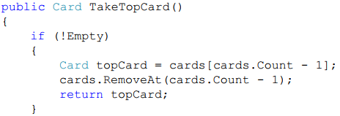
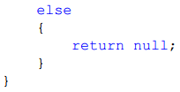
8.5 The Method Body
Review the method bodies for each of the methods in the Deck class
the TakeTopCard method

Slide 11
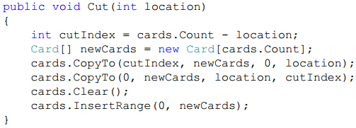
8.5 The Method Body
Review the method bodies for each of the methods in the Deck class
the Cut method

Slide 12

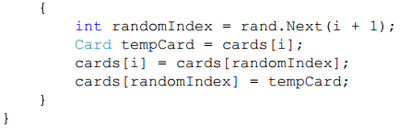
8.5 The Method Body
Review the method bodies for each of the methods in the Deck class
the Shuffle method

Slide 13
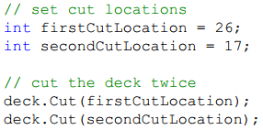
8.6 Parameters and How They Work
Whenever we associate an argument in the method call with a parameter in the method header, the value of that argument is copied into a temporary variable with the parameter name inside the method. This approach is called pass by value.
Note that this only applies to passing value types as parameters.
Look at a code fragment that simply cuts a deck in two different locations using the Cut method

Slide 14
8.6 Parameters and How They Work
In the method call, the parameter location corresponds to the argument firstCutLocation (remember, it matches number, order, and type for parameters), so the value of firstCutLocation gets copied into location.
After the method finishes, the deck will have been cut at the location given in firstCutLocation. Now we call the method again, this time associating the location parameter with the secondCutLocation argument. That means that the value of secondCutLocation gets copied into location. After the method completes this time, the deck will have been cut at the location given in secondCutLocation.

Slide 15
8.7 Passing Objects as Parameters
We can’t really pass an object by its value, because the compiler needs to “set aside space” for parameters that are passed by value, and the compiler can’t know before we run the program exactly how big the object will be as we run the program.
For example, think of passing a StringBuilder object into a method. How many characters long will the StringBuilder be when we pass it into the method? In most cases, we don’t know, so we can’t pass the entire object as a value when we’re passing objects as parameters.

Slide 16
8.8 Passing Objects as Parameters
For objects, C# doesn't actually pass the entire object as a value – it passes a reference to the object as the value instead.
Think of this as passing the memory address of the object rather than the actual object.
For example, say we have a StringBuilder object called message, with the value "Hi There!" that’s stored in memory starting in memory location 40 as shown in the next slide

Slide 17
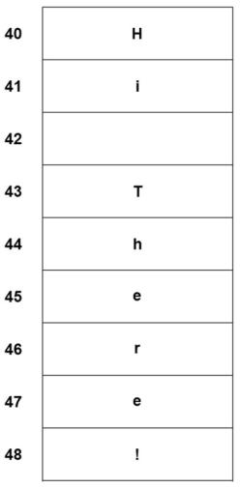
8.8 Passing Objects as Parameters
StringBuilder Object in Memory

Slide 18
8.8 Passing Objects as Parameters
When the StringBuilder is passed as an argument, it’s actually the address of the StringBuilder object (40) that’s passed rather than the object itself. The compiler can handle this without any trouble, because it simply needs to set aside enough space for an address rather than for the object itself.
When we pass objects as arguments to a method, within the method, we can change the contents of the object (changing the contents of our StringBuilder object, for example) without changing the address, so we can actually change a parameter within a method if it's an object.
It's kind of like changing the furniture in a house; the contents of the house change, but the address stays the same.

Slide 19

8.8 Passing Objects as Parameters
Say we had the following method (comments are omitted for the sake of brevity), which simply replaces all occurrences of 'e' in the string builder object with 'o' instead.
We pass our StringBuilder object in as an argument using
After the method runs, our message will now be "Hi Thoro!". That’s because we passed the address of the object as an argument rather than the object itself.

Slide 20
8.8 Passing Objects as Parameters
When we change an object that was passed as an argument to a method inside that method, this change is called a side effect.
It's called a side effect because the fact that the object might be changed inside the method isn't obvious from the return type of the method or the list of parameters.
There are absolutely many times when we want to change object parameters in a method, but be careful when you do this. Errors caused by side effects are very difficult to find, so whenever you implement changes to object parameters inside your method, do so with care.

Slide 21
8.8 Passing Objects as Parameters
We could use literals rather than variables for arguments that were value types.
We can't do that for objects, of course, because there's no way to just use a literal value for an object (unless we use null, which isn’t usually useful).
We can, however, create a new object for the argument if we don't happen to have an object already created.
For example, in the constructor for our Deck class, we used
to create new cards as arguments for the Add method in the List class.

